Slide 1





Social influence on adolescent and adult exploration in uncertain environments
Andrea Gradassi, UvA, Developmental Psychology
Simon Ciranka,
MPI Berlin
Wouter van den Bos,
UvA

Slide 2
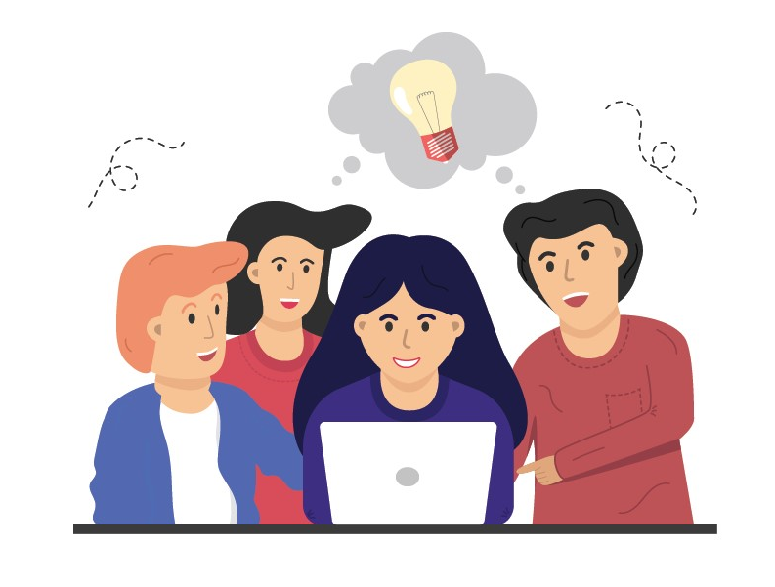
Social influence = social learning
Copying the behaviour of others to improve performance and avoid trial and error
Notes:
We look at social influence from the perspective of social learning, i.e. ..
Why is it interesting to study social learning in adolescence?

Slide 3

1: The world becomes larger
Forming an identity,
developing relationships,
becoming independent.
Notes:
Why is interesting to look at social influence/learing in adolescence?
Time of change. The world becomes larger, simply by that, behavior becomes increasingly more exploratory

Slide 4
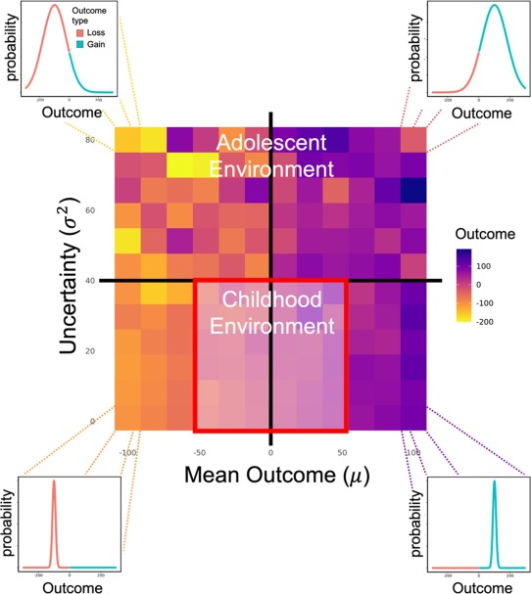
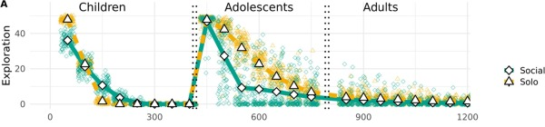
1: The world becomes larger
Simply because they had more options, agents explored more and took more risks.
Ciranka & van den Bos,
Developmental Review, 2021
Notes:
The idea that a change in the environment triggers changes in behavior has been explored in this study by… where

Slide 5
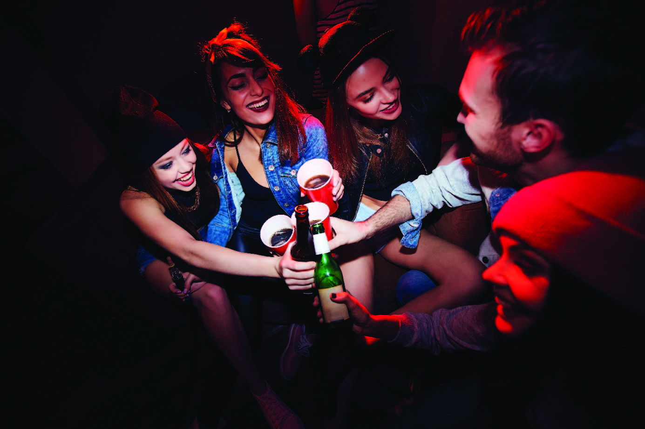
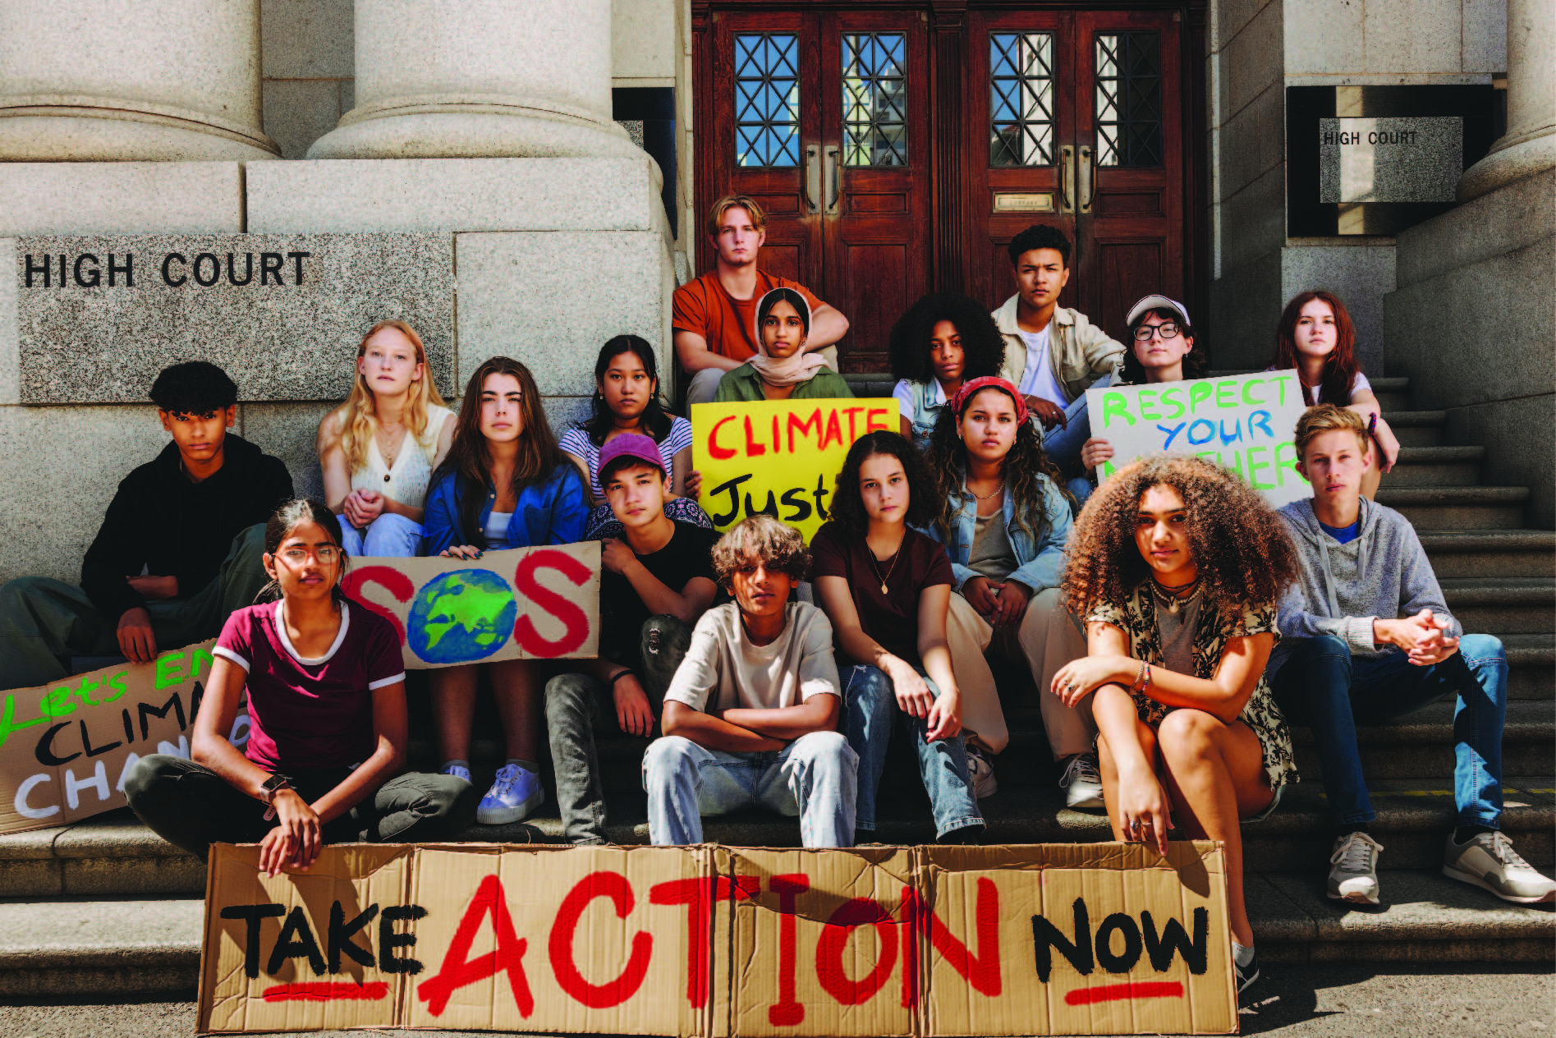
2: Window of high social sensitivity
Notes:
The second element, is social sensitivity. This could be positive or negative, a lot of research on bad, because it encourages risk-taking behaviours. However, there are also examples where social influence leads to so-called pro-social risk taking.

Slide 6
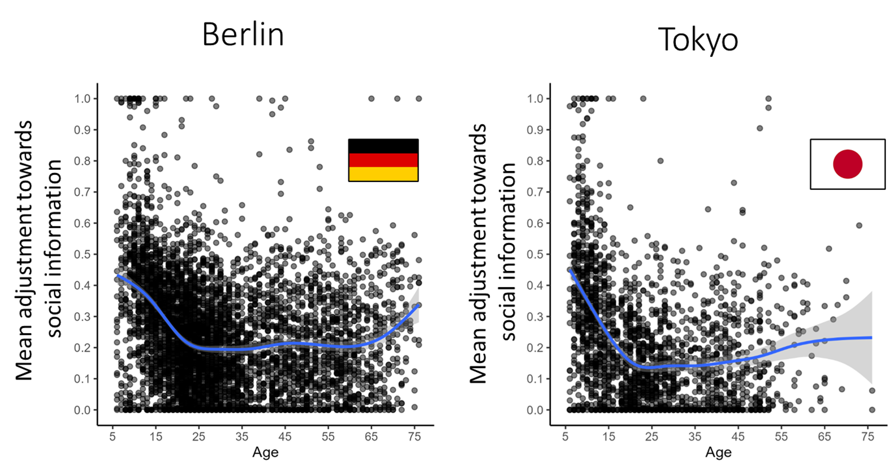
2: Window of high social sensitivity
Molleman et al., in prep.
Notes:
A graph showing on the y axis how much people use social information across the lifespan:
Adolescence is not as high as childhood, but then kids don’t go around taking risks and being independent; they are in controlled environments

Slide 7
Could sensitivity to social influence be adolescents’ superpower, allowing them to thrive in uncertain environments?
Environment structure
×
Social sensitivity
Notes:
So what is interesting about adolescence, is this unique combination of 1) expanding environment 2) realitevly high social sensitivity. What we ask in this study is,

Slide 8


Slide 9
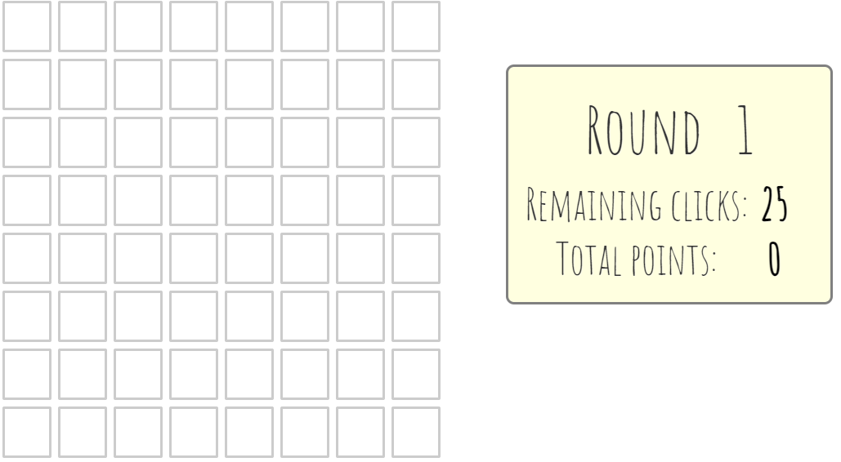
Notes:
We tried to condense this very abstract concept in an experiment

Slide 10
Notes:
2 things: first you don’t explore alone.

Slide 11
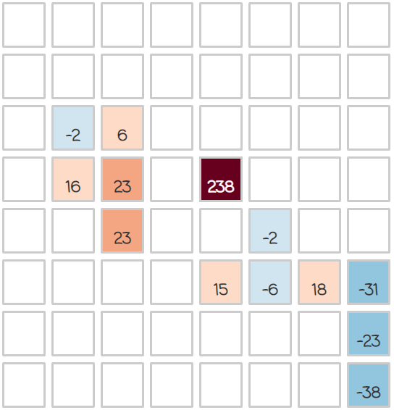
Notes:
Second there are incentives to explore

Slide 12
This is a gem!
Highly rewarding tiles,
that make exploration and risk-taking worth it.

Slide 13
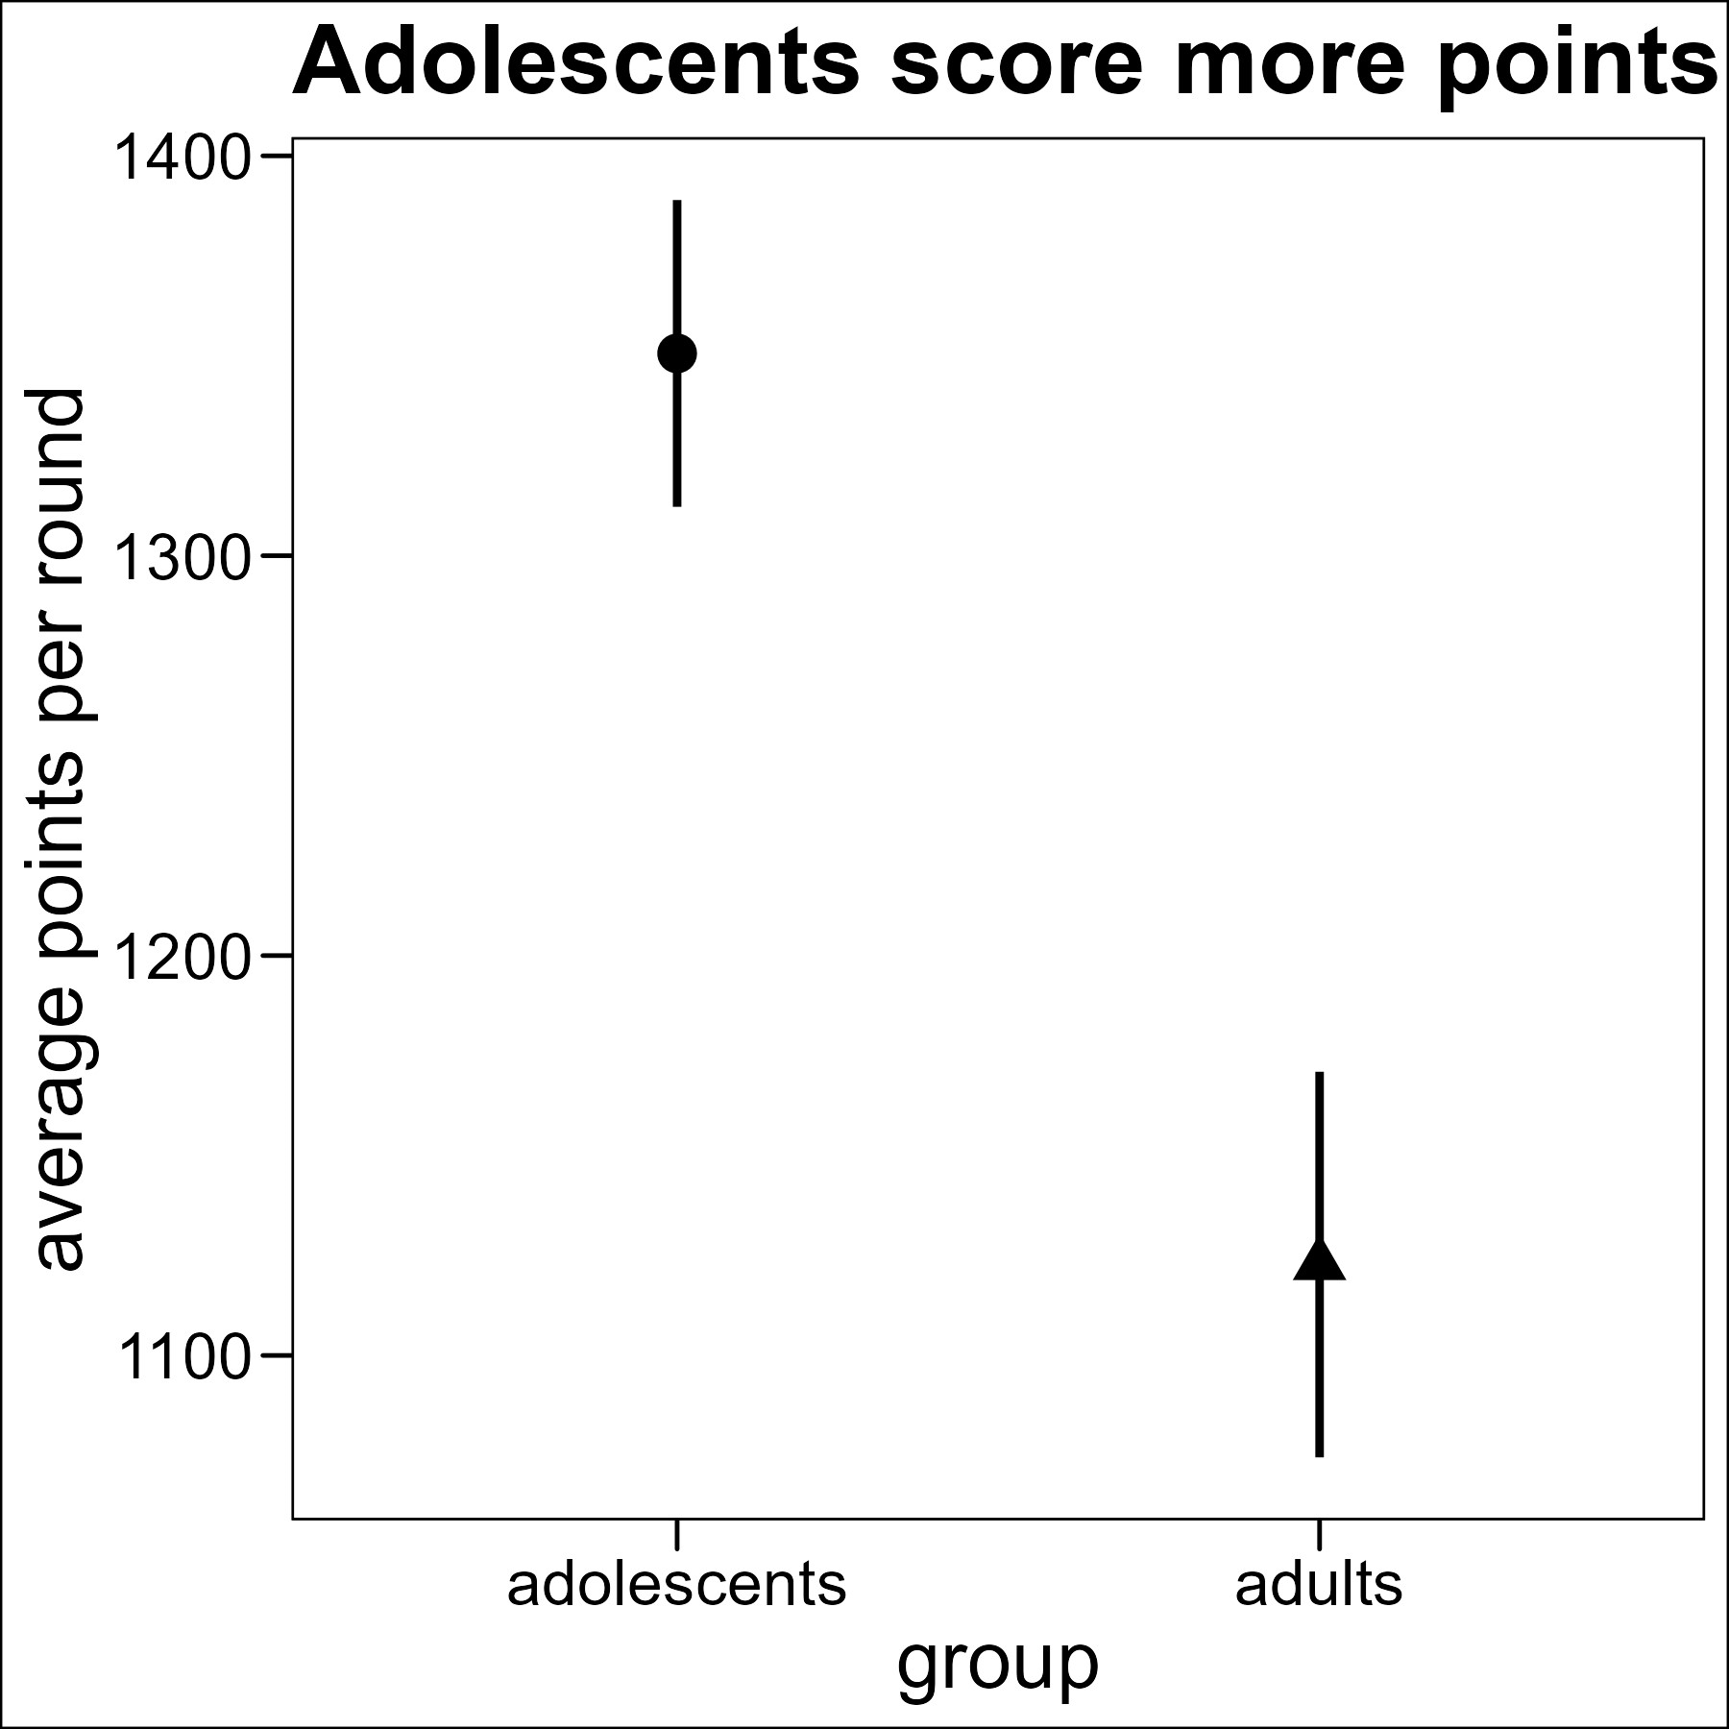
Results: performance
Adolescents
Adults
N = 187
N = 105
***

Slide 14
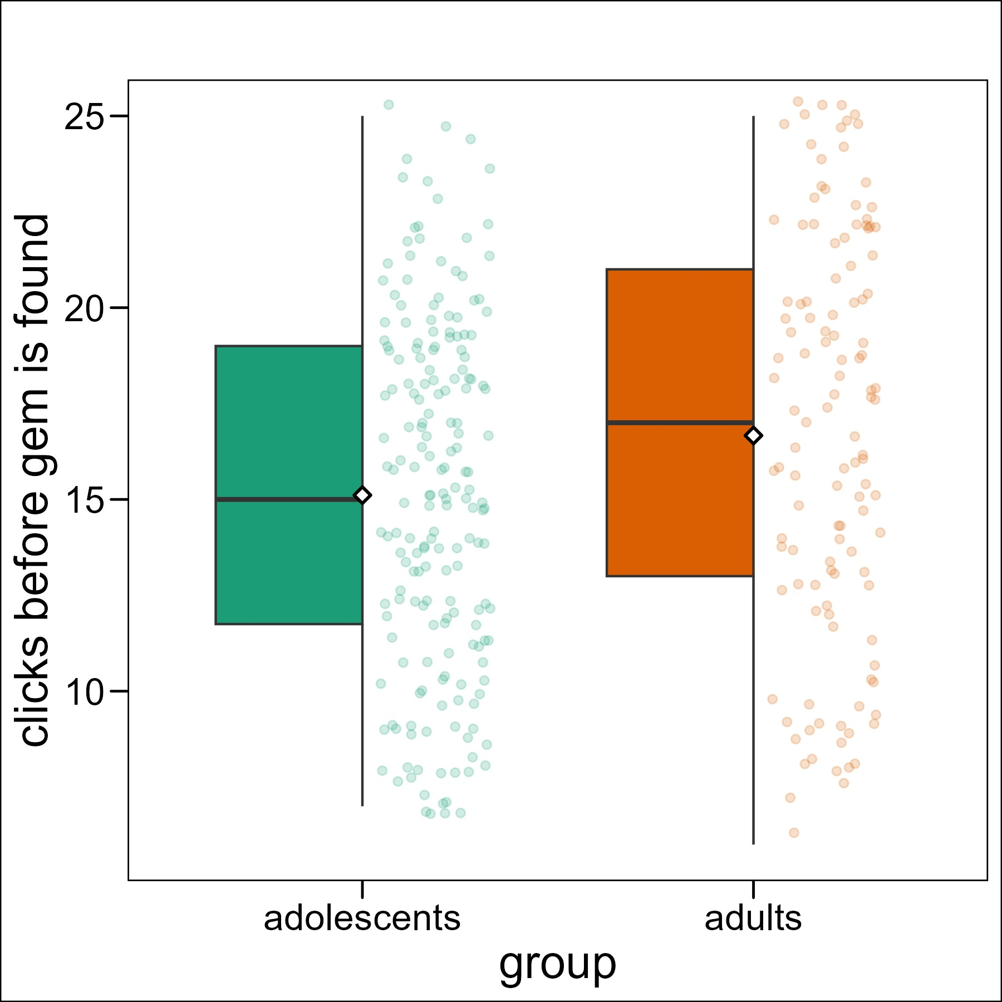
Results: exploration
Adolescents
Adults
N = 187
N = 105
*

Slide 15
Results: social learning
Adolescents
Adults
N = 187
N = 105
Notes:
Before results: showing that adolescents perform better, or even equal to adults in behavioral task is very hard

Slide 16
Results: summary
Adolescents:
1. Score more points
2. Find ‘gems’ earlier
3. Use more social information when it is beneficial
Notes:
Before results: showing that adolescents perform better, or even equal to adults in behavioral task is very hard

Slide 17
Take away message
By copying others more, adolescents were able to find ‘gems’ earlier, and thus score more points.
Higher social sensitivity helped adolescents perform better.
Notes:
Kind of a dense title so let me unpack a little bit the concept

Slide 18
Future steps
Apply computational modeling
Increase number of players to study group dynamics
Notes:
Kind of a dense title so let me unpack a little bit the concept

Slide 19


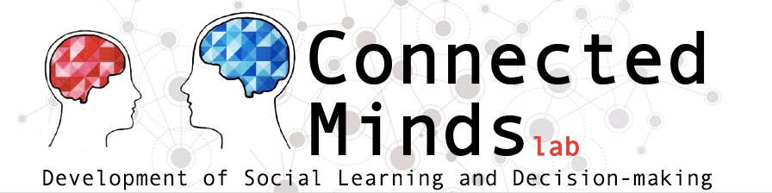

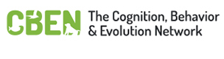
Thank you!
Wouter van den Bos
Simon Ciranka
Lucas Molleman

